Slide 1
Multi-threaded Merge-Sort
Jash Pithadia
Viraj Shah
Vivek Shah

Slide 2
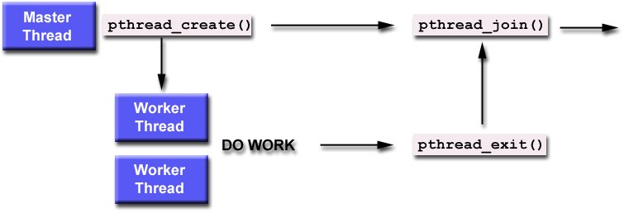
What are threads?
A POSIX thread is a single flow of control within a process. It shares a virtual address space with other threads in the same process

Slide 3
Pthread Functions
1. pthread_create (&thread, attr, start_routine, &arg):
&thread: unique identifier for the new thread returned by the subroutine
attr: attribute object that may be used to set thread attributes. You can specify a thread attributes object, or NULL for the default values
start_routine: a routine that the thread will execute once it is created.
&arg: A single argument that may be passed to start_routine. It must be passed by reference as a pointer cast of type void NULL may be used if no argument is to be passed.
2. pthread_exit (status): pthread_exit is used to explicitly exit a thread. Typically, the pthread_exit() routine is called after a thread has completed its work and is no longer required to exist.
3. pthread_join (threadid, status): This function is called from within the parent thread and the first argument is the thread ID of the thread to wait on and the second argument is the return value of the thread on which we want to the parent thread to wait. If we are not interested in the return value then we can set this pointer to be NULL

Slide 4
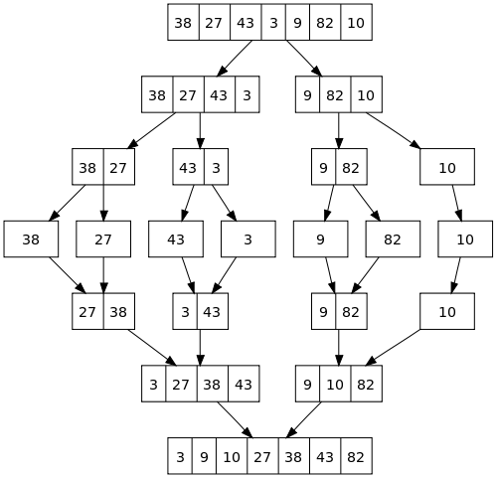
start_thread
a[]
pthread_create()
pthread_create()
thread1
thread2
thread1
thread2
pthread_join()
pthread_join()
b[]

Slide 5
Thank you

